Slide 1
Lunchmates

Slide 2
Was?
Android App
Zum Finden von Lunchmates auf dem Campus, Ansehen der aktuellen Lunchgelegenheiten,Position der Lunchmates und der aktuellen Speiseplänen der Gastronomiebetriebe am Campus.
Server
REST API mit Node.js/Express zum serverseitigen Datenaustausch und Verwaltung.

Slide 3
1.
Diagramme

Slide 4
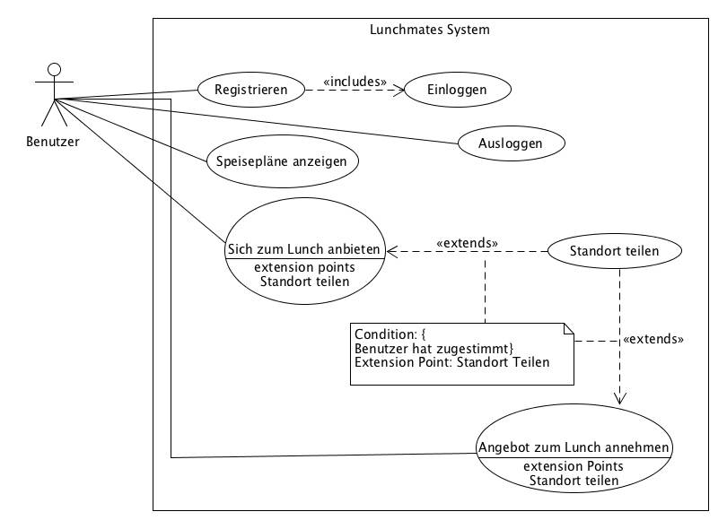

Slide 5
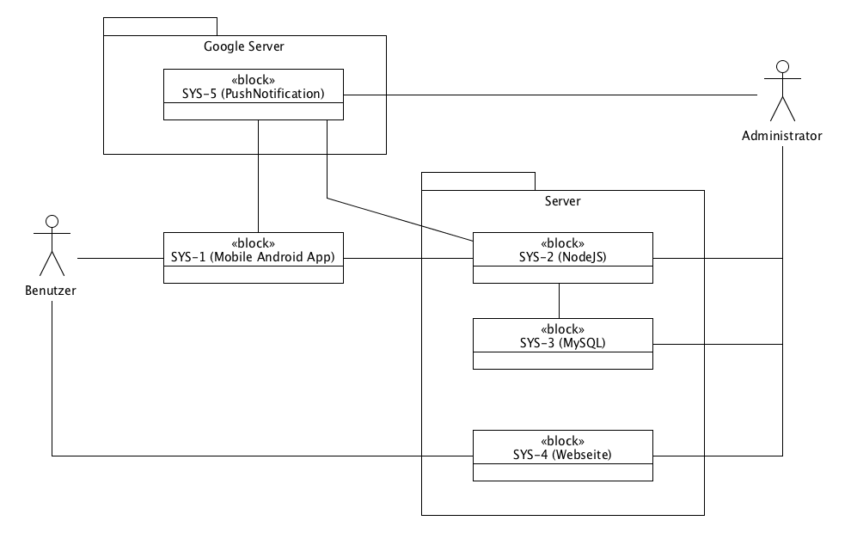

Slide 6
2.
Persona

Slide 7
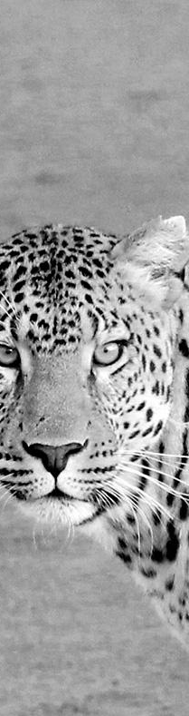
Hallo!
Das ist Sören
32 Jahre alt
Studiert Sozialwissenschaften im 26. Semester
In Unna geboren
Pendelt von dort jeden Tag nach DO.
Single.

Slide 8
Sören Langenfeld
Verkäufer in einem BIO-Feinkostgeschäft.
In seiner Freizeit engagiert sich gerne für die Umwelt und guckt gerne Serien auf Streamingportalen.
Besitzt Samsung Galaxy S3 mini.
Bevorzugte Apps: Threema, Chefkoch, Spotify.

Slide 9
3.
Szenario

Slide 10
Stellen Sie sich vor, dass Sören…
Besucht VL
Will essen gehen
Findet keine Kommilitonen

Slide 11
Lunchmates
In der Situation kommt Lunchmates in einsatz.

Slide 12
Stellen Sie sich vor, dass Sören…
Bietet er sich zu gemeinsamen Essen
Deaktiviert Standortsmitteilungsfunktion
Findet Kommilitonen zur gemeinsamen Essen

Slide 13
The thing that we are trying to do (…) , is just help people connect and communicate more efficiently.

Slide 14
4.
Interaktionsdesign

Slide 15
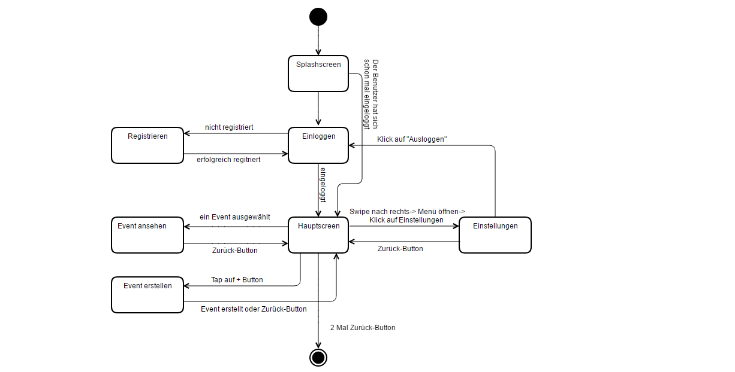

Slide 16
5.
Mockups

Slide 17
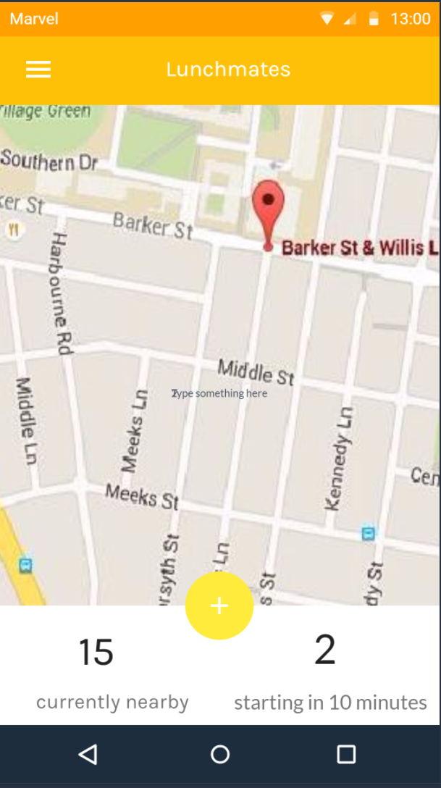
Main Screen
Zum Anzeigen und Erstellen von Einladungen
Place your screenshot here

Slide 18
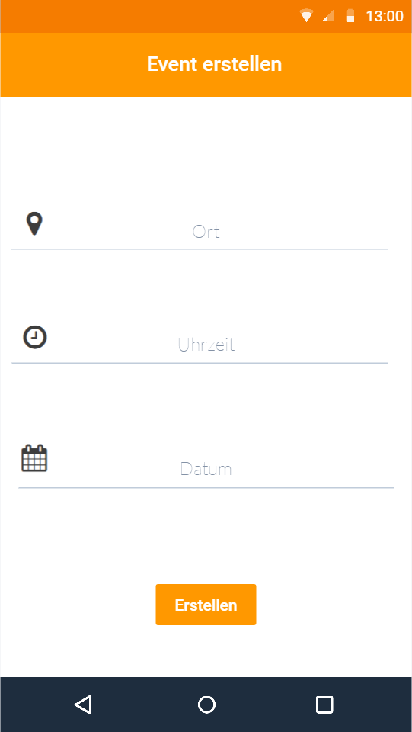
Event Erstellen
Zur Erstellung von Events
Place your screenshot here

Slide 19
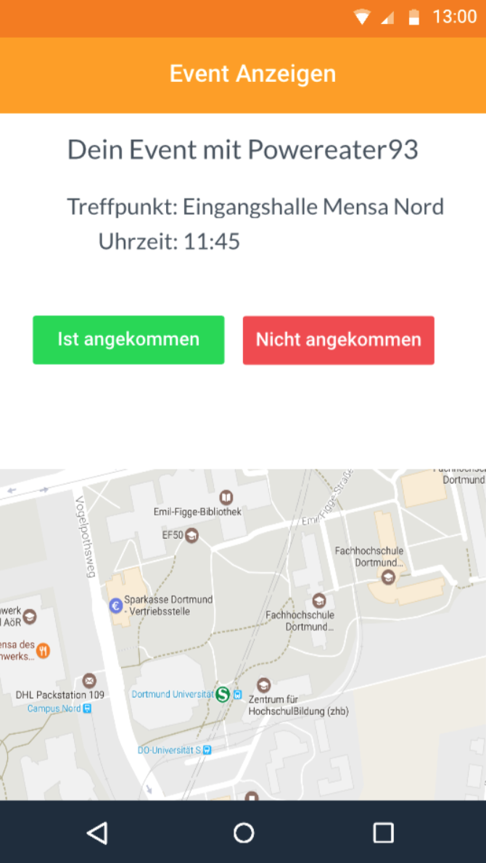
Event Anzeigen
Zur Anzeigen von Events und der Route
Place your screenshot here

Slide 20
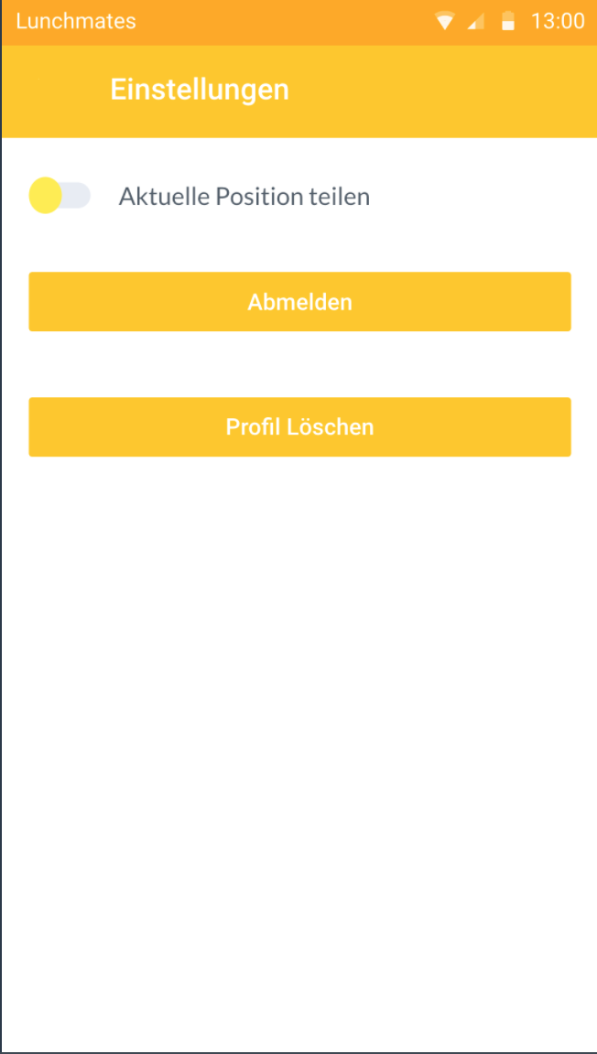
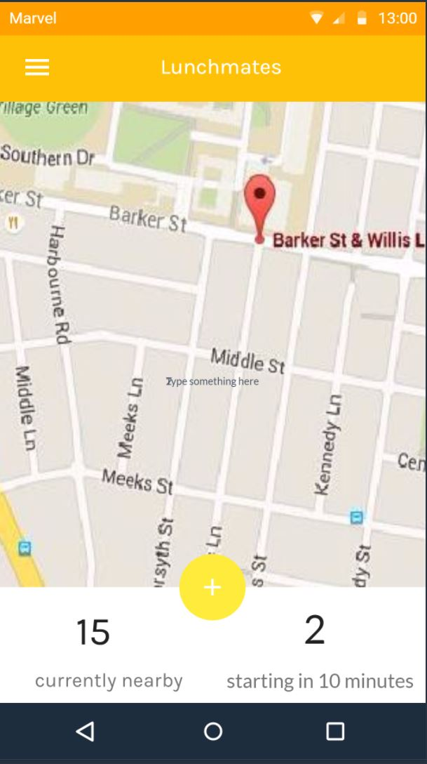
Einstellungen
Zur begrentzten Personalisierung des Apps
Place your screenshot here

Slide 21
You can also split your content
White
Is the color of milk and fresh snow, the color produced by the combination of all the colors of the visible spectrum.
Black
Is the color of coal, ebony, and of outer space. It is the darkest color, the result of the absence of or complete absorption of light.

Slide 22
In two or three columns
Yellow
Is the color of gold, butter and ripe lemons. In the spectrum of visible light, yellow is found between green and orange.
Blue
Is the colour of the clear sky and the deep sea. It is located between violet and green on the optical spectrum.
Red
Is the color of blood, and because of this it has historically been associated with sacrifice, danger and courage.

Slide 23
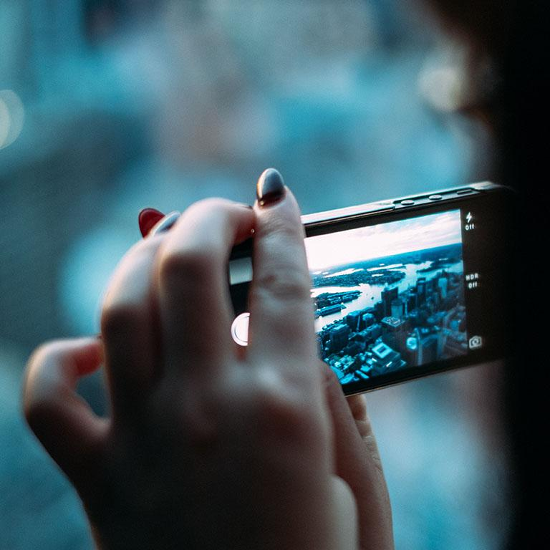
A picture is worth a thousand words
A complex idea can be conveyed with just a single still image, namely making it possible to absorb large amounts of data quickly.

Slide 24
Want big impact?
Use big image.

Slide 25
Use charts to explain your ideas
Studenten
Gray
Black

Slide 26
And tables to compare data
 | A | B | C
Yellow | 10 | 20 | 7
Blue | 30 | 15 | 10
Orange | 5 | 24 | 16

Slide 27

Maps
our office

Slide 28
89,526,124
Whoa! That’s a big number, aren’t you proud?

Slide 29
89,526,124$
185,244 users
100%
That’s a lot of money
And a lot of users
Total success!

Slide 30
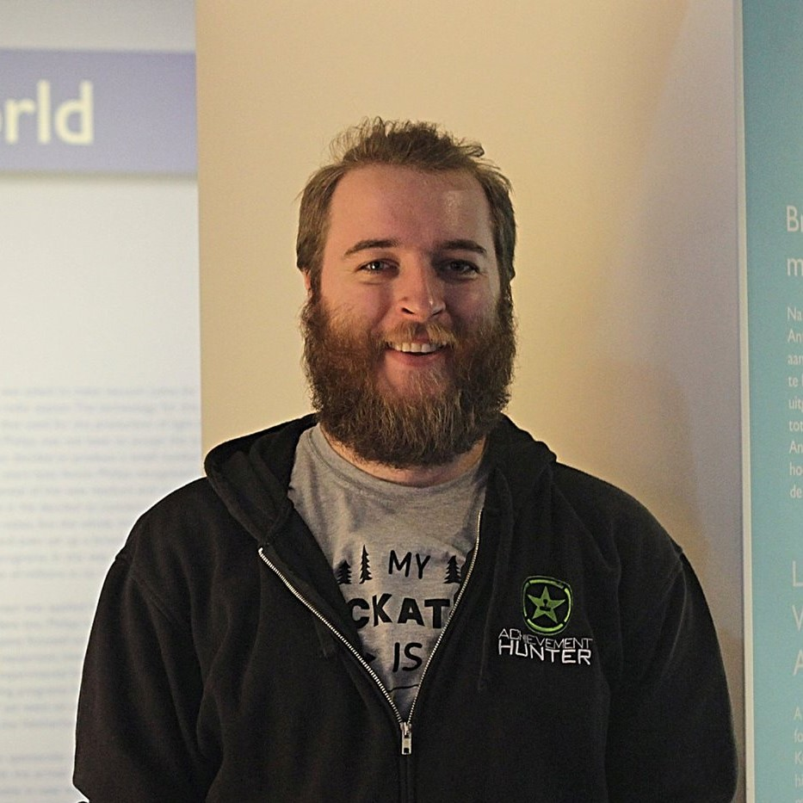
Let’s review some concepts
Mikolaj
Wawrzyniak
Is
Sönke
Tölke
courage.
Emir
Drustinac
Is
Jonas
Fleck
Is

Slide 31
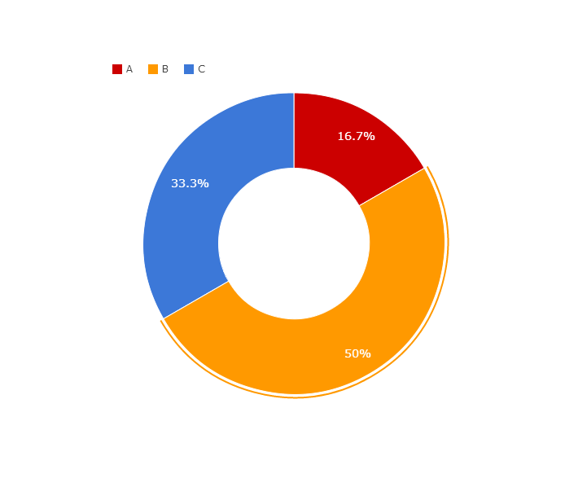
You can copy&paste graphs from Google Sheets

Slide 32
iPhone project
Show and explain your web, app or software projects using these gadget templates.
Place your screenshot here

Slide 33
Tablet project
Show and explain your web, app or software projects using these gadget templates.
Place your screenshot here

Slide 34
Place your screenshot here
Desktop project
Show and explain your web, app or software projects using these gadget templates.

Slide 35
Vielen Dank!
Fragen?
Unsere Projekt:
https://github.com/spejss/Lunchmates

Slide 36
Credits
Special thanks to all the people who made and released these awesome resources for free:
Presentation template by SlidesCarnival
Photographs by Unsplash

Slide 37

Presentation design
This presentations uses the following typographies and colors:
Titles: Raleway
Body copy: Lato
You can download the fonts on this page:
https://www.google.com/fonts#UsePlace:use/Collection:Lato:400,700,400italic,700italic|Raleway:400,700
Click on the “arrow button” that appears on the top right
Dark blue #2185c5
Light blue #7ecefd
Yellow #ff9715
Magenta #f20253
Dark gray #677480
Light gray #97abbc
You don’t need to keep this slide in your presentation. It’s only here to serve you as a design guide if you need to create new slides or download the fonts to edit the presentation in PowerPoint®

Slide 38
SlidesCarnival icons are editable shapes.
This means that you can:
Resize them without losing quality.
Change fill color and opacity.
Change line color, width and style.
Isn’t that nice? :)
Examples:

Slide 39
😉
Now you can use any emoji as an icon!
And of course it resizes without losing quality and you can change the color.
How? Follow Google instructions https://twitter.com/googledocs/status/730087240156643328
✋👆👉👍👤👦👧👨👩👪💃🏃💑❤😂😉😋😒😭👶😸🐟🍒🍔💣📌📖🔨🎃🎈🎨🏈🏰🌏🔌🔑 and many more...

